Slide 1
MGMT 6057 contemporary business management
Module 7: marketing

Slide 2
Agenda
Marketing definition
Segmentation
Target market
The Marketing Mix (“4 P’s of Marketing”): Product, Place, Promotion, Price
Brands, branding strategies, brand equity
Customer relationship management
Social media marketing
Relevance for project management and business ownership

Slide 3
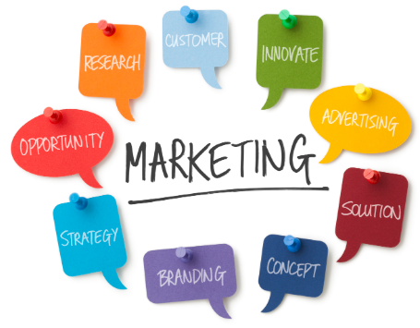
marketing
More than advertising and sales!
Activities that organizations do to identify and satisfy customer needs, including:
Defining a product/service’s features and benefits
Setting the price
Identifying the target market
Making potential customers aware
Getting people to buy
Delivering it to people who buy
Managing relationships with customers after product/service has been delivered
Notes:
Image: http://zezoo.com/wp-content/uploads/2016/01/marketing-solutions2.jpg

Slide 4
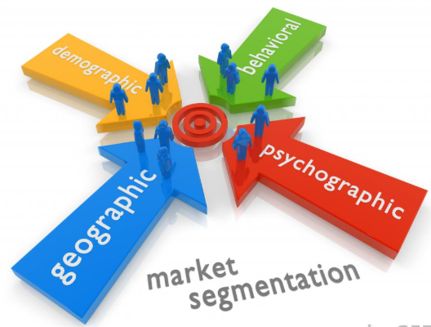
Segmentation
First, identify your overall market: potential customers who could be interested in your product, who would have access to it, and who have the means to buy it
Then, divide the market into sub-groups (segmentation) based on one or more categories, such as:
Demographic segmentation
Geographic segmentation
Behavioural segmentation
Psychographic segmentation
Notes:
Potential customers may be in consumer market and/or industrial market
Image: https://images.wisegeek.com/market-segmentation.jpg

Slide 5
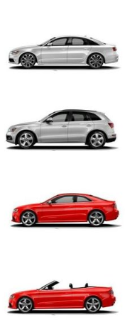
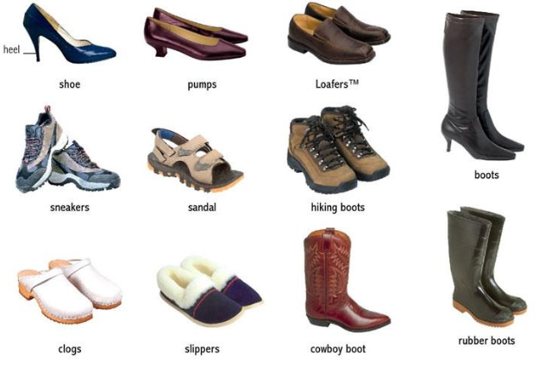

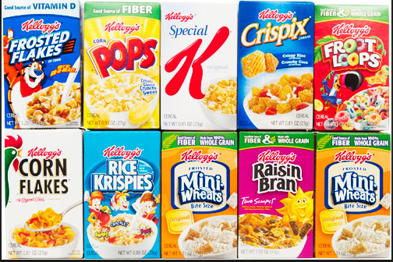
segmentation
How might you segment these markets?
Cars
Cereal
Footwear
Shampoo
Notes:
Images:
https://www.seriouseats.com/images/2011/08/20110829-mini-cereal-boxes-10.jpg
https://i.pinimg.com/736x/df/63/7a/df637aa009f319855a5ed1f1e93dd6f0--body-types-types-of.jpg
http://www.topcount.co/wp-content/uploads/2017/06/21.jpg

Slide 6
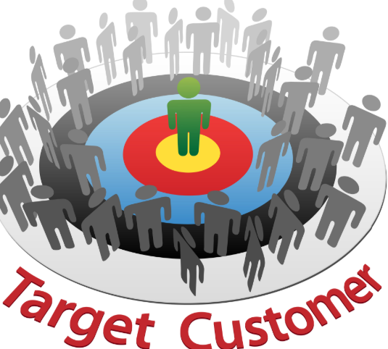
Target markets
Once you have completed market segmentation, identify your target market … because it may be challenging (and expensive) to sell your product/ service to your entire market!
Target Market: The market segment(s) that you will focus your marketing activities on
Notes:
Potential customers may be in consumer market and/or industrial market
Image: https://www.dlbconsulting.com/wp-content/uploads/2015/08/7-28-DLB-targetmarket.jpg

Slide 7
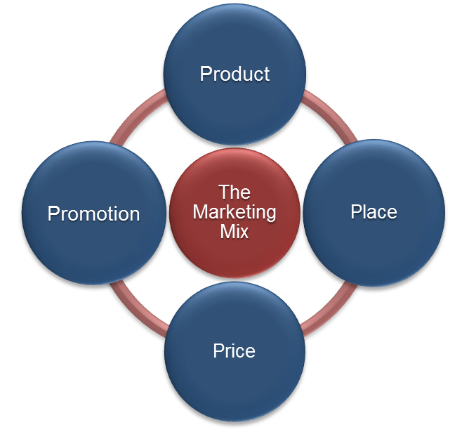
The Marketing mix (4 P’s of marketing)
Notes:
Figure CC BY 4.0. Retrieved from: https://commons.wikimedia.org/wiki/Category:Figures_from_Fundamentals_of_Business_by_Skripak

Slide 8
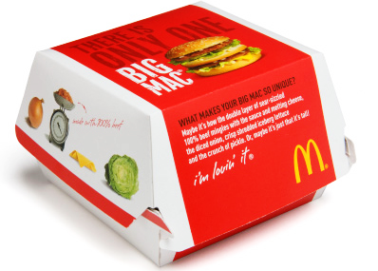
product
Derived from customer needs and wants
Determined from secondary and primary research
Includes product features and characteristics that deliver value to customers
Includes packaging
Functional and promotional purposes
Must follow labelling laws
Notes:
Image: http://2.bp.blogspot.com/-ZKhpZl5POMs/TlMtzYnhbmI/AAAAAAAABpY/RRoC2ybtCzY/s1600/7.png

Slide 9
Brands and branding
Brand: what differentiates your product (or company) from similar products (or companies) in the market
Brand identity: words, letters, sounds, symbols
Brand image: impressions or beliefs regarding the brand
Branding strategies: private, generic, or manufacturer branding
Brand equity: any added value generated by favourable consumer experiences

Slide 10




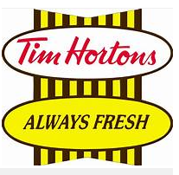





Top Canadian brands
Notes:
https://www.canadianbusiness.com/lists-and-rankings/best-brands/canadas-best-brands-2017-the-top-25/#gallery/canadas-best-brands-2017/slide-1

Slide 11
Place (distribution)
How the final product/service gets to the customer
Common Distribution Channels
Producer
Agent /
Broker
Wholesaler
Retailer
Consumer
Producer
Wholesaler
Retailer
Consumer
Producer
Retailer
Consumer
Producer
Consumer
Notes:
Agent channel: e.g., imported goods
Wholesaler channel: e.g., Johnson & Johnson
Retailer channel: automobile dealerships
Direct: e.g., e-commerce (e.g., Etsy) or service producer (e.g., hair salon)
Company can use multiple distribution channels
Emerging trends include drone delivery, etc.
Marketing is not the same as logistics
[Discussion: Where would Amazon fit into this list of distribution channels?]

Slide 12
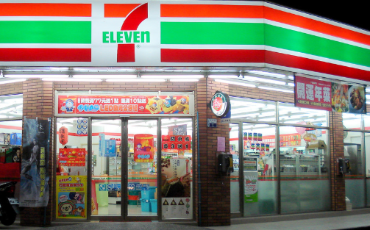
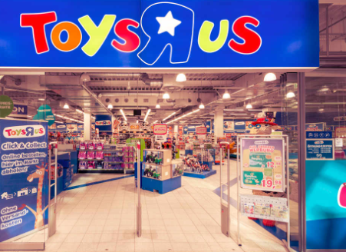
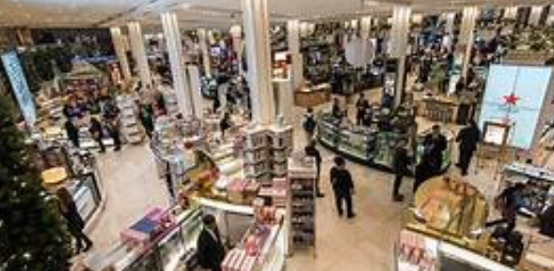
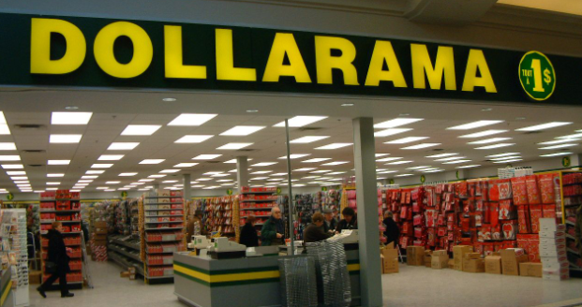
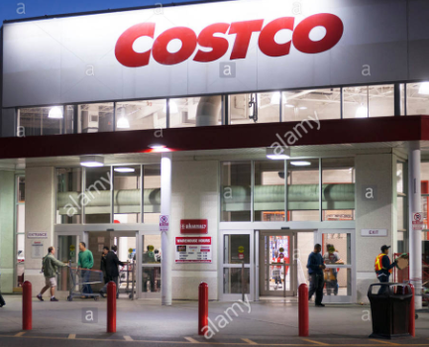
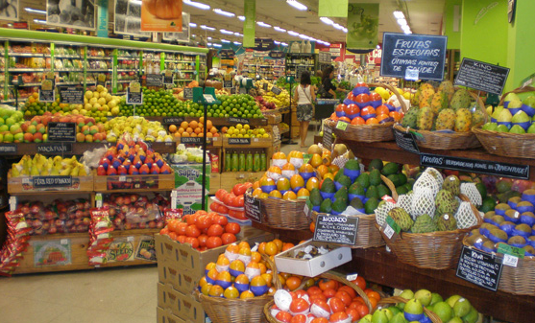
Types of retailers
Category killer
Convenience store
Department store
Discount store
Specialty store
Supermarket
Warehouse club
Notes:
Discussion: Would companies such as Amazon be considered a type of retailer?
Images: https://www.foodamentals.com/wp-content/uploads/2016/04/7-Eleven.jpg
http://www.citti-park-kiel.de/fileadmin/_processed_/csm_toys_r_us_shop_foto_kiel_ce8e010b7a.jpg
http://www.cambridgeenglish.org/static-assets/Images/b1r002-shopping-department-store_tcm32-288839.jpg
http://media-cache-ak0.pinimg.com/originals/df/b9/10/dfb91095ddba4f9cc5bcbb724d652e4a.jpg
https://c8.alamy.com/comp/EA2B9R/costco-store-membership-warehouse-club-chain-in-the-evening-in-scarborough-EA2B9R.jpg

Slide 13
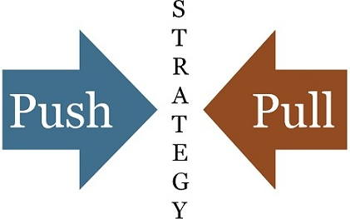
promotion
Educating and persuading the target market
“Push” strategy
Stimulate sales by increasing awareness of the product
“Pull” strategy
Stimulate demand from potential customers
Notes:
https://keydifferences.com/wp-content/uploads/2016/08/push-vs-pull-strategy1.jpg

Slide 14

Types of promotion
Advertising
Personal selling
Sales promotion
Public relations (PR)
Your promotional strategy will depend on: purpose of promotion, target market, product features to emphasize, budget, competitor promotion strategies
FYI…International Awards for Best Promotions: The Clio Awards
Notes:
Image: http://moziru.com/images/advertisement-clipart-promotion-5.png
(e.g., Clio award winner – Coke 2017 ‘1000 Song’ campaign) https://clios.com/awards/winner/audio-technique/coca-cola/1-000-song-celebration-39217

Slide 15
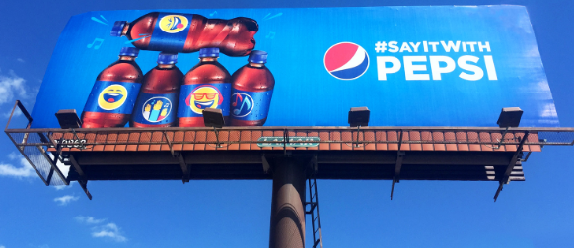
advertising
Paid non-personal communication designed to create awareness of product or company
Not as effective because of over-saturation of messaging
Most common form of promotion
Includes:
TV, radio
Newspapers, magazines
Internet, social media
Limited only by imagination (e.g., product placement in movies, space billboards, Shanghai QR code with drones)
Notes:
Image: https://branditprintit.com/wp-content/uploads/2017/05/hero_tulsa_bulletin_Pepsi_1600x900.jpg

Slide 16
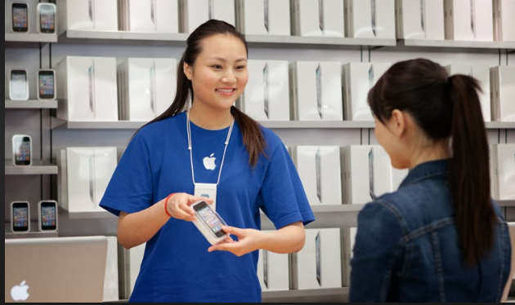
Personal selling
One-on-one communication with (potential) customers
Common for expensive items or complex purchasing arrangements
Notes:
Image: http://2.bp.blogspot.com/-Jb3vUaNkrLI/UnB8huL_JfI/AAAAAAAAAIo/EkujEfsWE5Y/s1600/shop_on_your_own.jpg

Slide 17
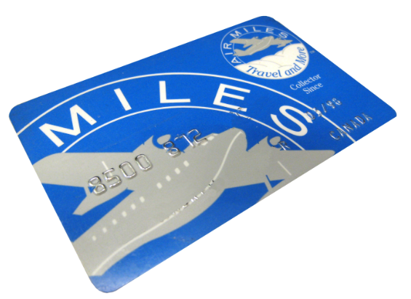
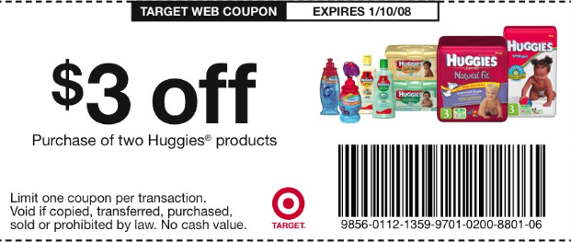
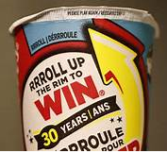
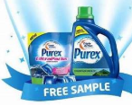
Sales Promotion
Designed to motivate people to buy now
Includes:
Discounts (sales)
Samples
In-store displays
Loyalty programs
Contests or sweepstakes
Notes:
Images: http://peterzafiris.com/wp-content/uploads/2013/06/Pepsi-Cola-Sales-Promotion.png
http://asklizweston.com/wp-content/uploads/2014/11/air-miles-card.jpg
https://tse2.mm.bing.net/th?id=OIP.Ez-ExBVE2R6rrpC9I3_TUwAAAA&pid=15.1&P=0&w=300&h=300
http://cdn.savings.com/img/Target-Coupons.jpeg
https://www.thestar.com/content/dam/thestar/news/canada/2017/02/09/3-charged-in-theft-of-tim-hortons-roll-up-the-rim-cups-in-belleville/roll-up-the-rimjpg.jpg.size.custom.crop.1086x725.jpg

Slide 18

Publicity and Public relations
Increasing public awareness of your company in the media at little or no cost
Public relations is actively managing the positive messaging/image of the company
Often involves issuing press releases/ statements
May be proactive or reactive
Publicity is like ‘free advertising’ but is typically outside of your control
May be positive or negative
Examples: Your company is profiled in a magazine, a journalist writes a blog article that mentions your firm
Notes:
Image: http://images.clipartpanda.com/publicity-clipart-publicity-newspaper-headline-attention-reporting-coverage-word-to-illustrate-you-your-company-product-organization-40334052.jpg

Slide 19
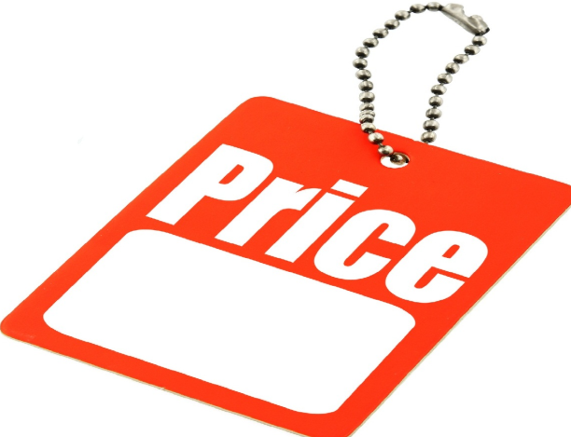
Pricing strategies
Price skimming: Price high to get customers with highest willingness to pay
Penetration pricing: Price low to build market share
Cost-based pricing: Good or bad?
Demand-based pricing: Use supply/demand
Dynamic pricing: Price varies with time and circumstances
Can you think of examples of companies (or products/services) that commonly use these strategies?
Notes:
Image: https://sellingout.com/wp-content/uploads/2014/06/red-price-tag1.jpg

Slide 20
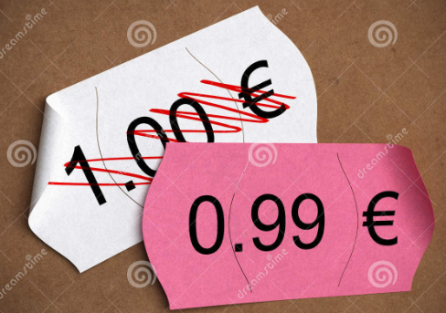
Pricing strategies (cont’d)
Prestige pricing: Give impression of high quality
Bundling: Combine multiple products or services
Odd-even pricing: $9.99 viewed as a better value than $10.00
Loss leaders: Price one item low, to entice customer to buy other products
Can you think of examples of companies (or products/services) that commonly use these strategies?
Notes:
Image: https://thumbs.dreamstime.com/z/psychological-price-pricing-21693187.jpg

Slide 21

Customer relationship management (CRM)
Keep customers happy, treat them well, give them what they want, listen to them, reward them for their loyalty, deal with their complaints
Goal is to retain customers
It costs more to attract/sell to a new customer (compared to an existing customer)
Repeat customers more likely to recommend your business/products
Requires collection of customer information (e.g., contact information, purchasing history)
Notes:
Image: https://www.ciol.com/wp-content/uploads/2018/08/Customer-Relationship-Management.jpg

Slide 22
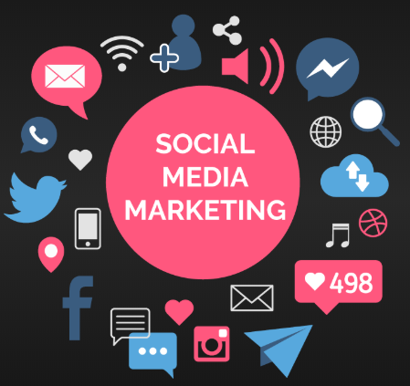
Social media marketing
Your presence on Twitter, Facebook, Instagram, LinkedIn, etc.
Increasingly important - more people online, fewer people watching television commercials or reading newspapers
Advantages: increases brand awareness, two-way communication, opportunity for promotional activities, customers interact with each other, channel for public relations, low cost
Challenges: privacy issues (collecting data about customers), time-intensive, ‘big data’ overload
Notes:
Image: https://magnetoitsolutions.com/wp-content/uploads/2017/12/smo-1.png

Slide 23
Relevance for project management and business ownership
Many marketing activities are project-based, including:
New product development
Product launches
Promotional campaigns
Marketing research studies
Business owners must make decisions about:
Identifying customers
The 4 P’s
Social media marketing
Customer relationship management

